Slide 1

AWS Console
A brief overview

Slide 2
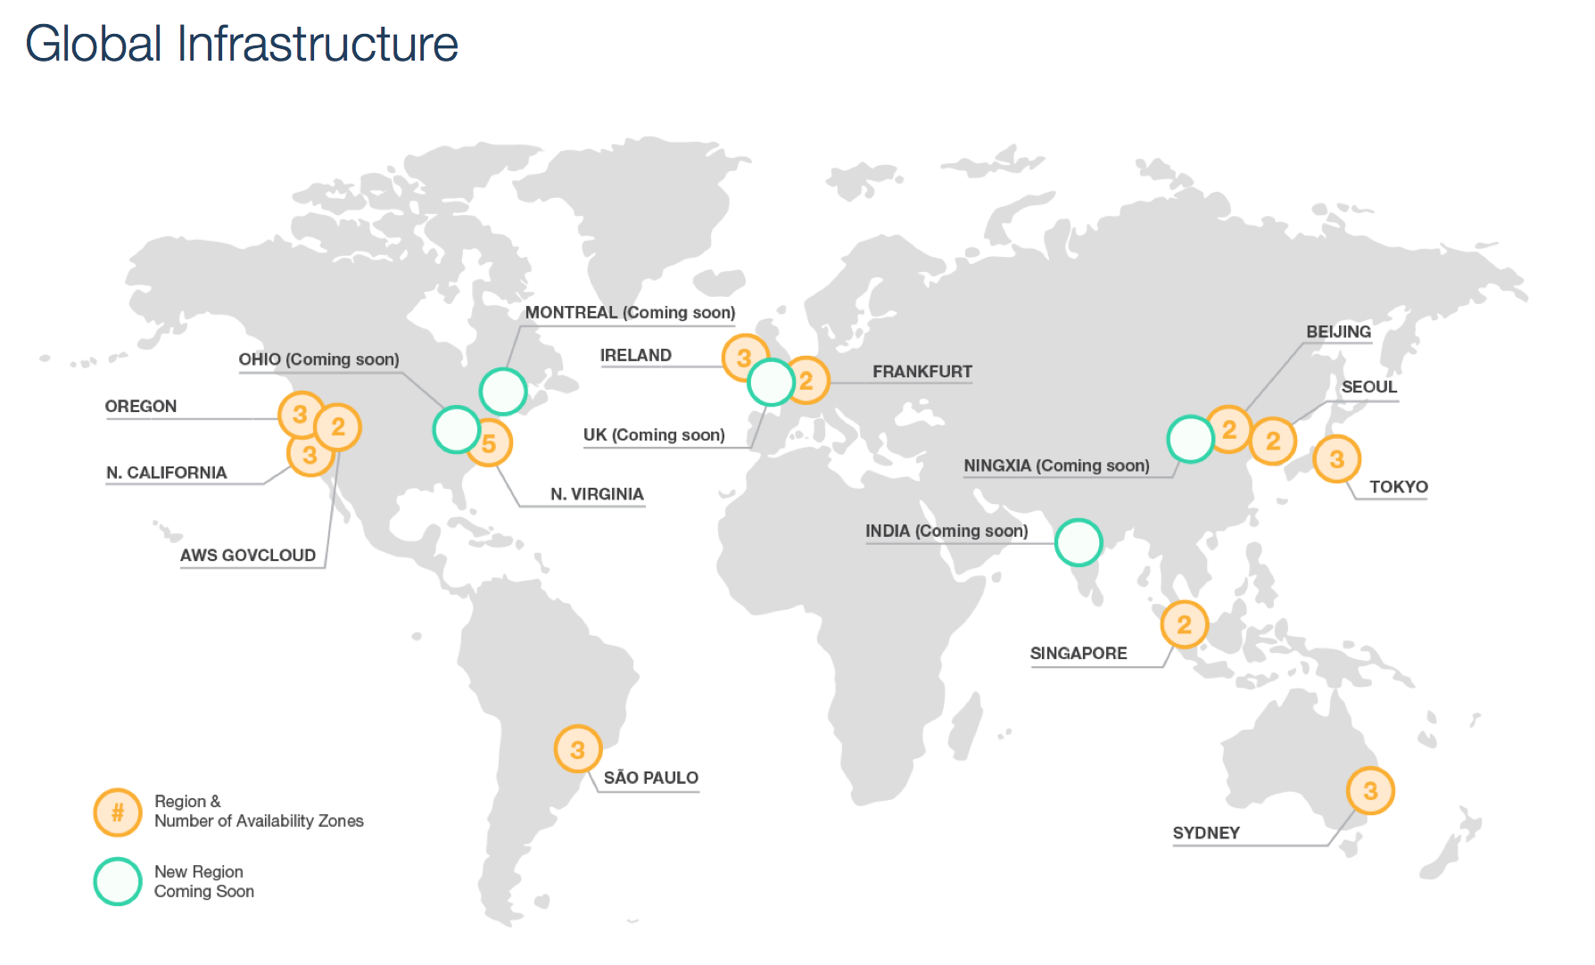
AWS Console
AWS Regions

Slide 3
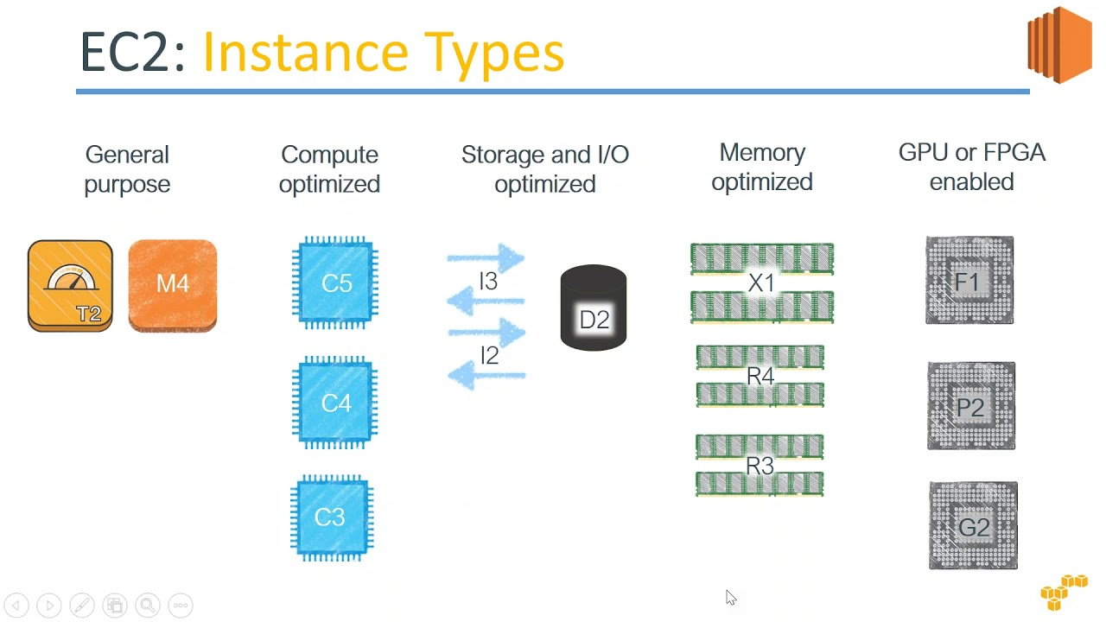
AWS Console
AWS Elastic Compute Cloud (EC2)
Instance Types
My Guide
T is good for prototyping
M for when you want something bigger
C when you want a lot of CPU power
R when you want to download more RAM.
Really, either use T, M, C, or R

Slide 4
AWS Console
AWS IAM
IAM is permissions & authentication in AWS between people & servers.
For me (admin) to talk to my S3 buckets
For one EC2 to talk to Lambda
For lambda to talk to SQS

Slide 5
AWS Console
Architecture
EC2
Client
SQS
S3
Lambda
RDS

Slide 6
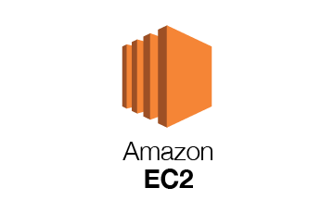
AWS Console
EC2 Demo
Operating System – Windows + RDP OR your favorite flavor of linux
Volumes – Default 8 gigs
Security Groups
Restrict port 22 (SSH) to certain IPs
expose ports

Slide 7
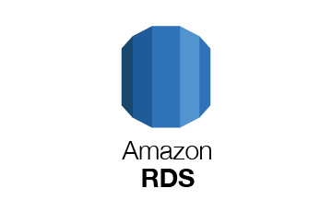
AWS Console
RDS Demo
Supported Databases:

Slide 8
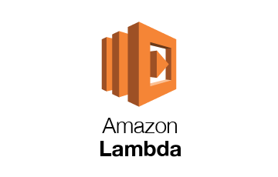
AWS Console
Lambda Demo
Runs arbitrary code
It’s a ”function” because you can call it parameters, and it just runs code.
PROS
Great for parallel processing and doing heavy tasks
Pay-per-use model
CONS
Hard to test on local
15 minute timeout

Slide 9
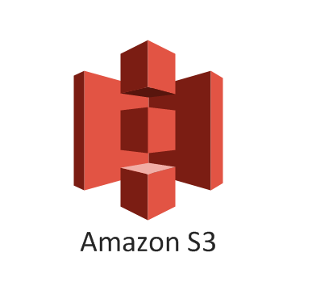
AWS Console
S3 Demo
S3 File Store
A note on File Systems vs Distributed Blob Storage
File Systems are consistent, and mounted to a singular volume. Not distributed.
Blob Storage is distributed, and thus ‘eventually consistent’

Slide 10
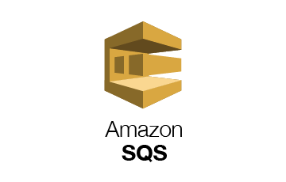
AWS Console
Simple Queueing Service Demo
SQS stands for simple queueing service
Can be configured for FIFO or unordered
Works based of a ‘visibility timeout’ parameter

Slide 11
AWS Console
Honorable Mentions
AWS IAM – Restricting Access from certain machines to other machines
Route 52/Elastic IP – DNS Routing & CNAMEs
AWS VPC – Don’t expose your DB to the public
AWS Elastic Beanstalk – Autoscaling servers based off of CPU usage.
ECS/Fargate – Serverless deployment of Docker containers in the cloud.

